Slide 1




Gender Barometer Survey Armenia 2014
Overview and
Selected Preliminary Results

Slide 2
Background and Objectives
The Gender Barometer Survey (GBS) was implemented under the Women’s Leadership Program – Armenia, a partnership between Higher Education for Development, Arizona State University, and Yerevan State University (Armenia).
The three-year partnership (ends in June 2015) has deployed various activities in three interrelated areas—instruction, policy research, and outreach.
GBS is a key element of the partnership’s policy research and outreach components
Main objectives of GBS:
To produce a nationally representative picture of gender-related views, attitudes, and perceptions in Armenian society
To use the findings to influence legislation and policy
To build research expertise at the YSU Center for Gender and Leadership Studies (CGLS)
To establish a baseline upon which future survey waves will be built

Slide 3
Design
Nationally representative sample, N=2134
Yerevan (the capital city)
Urban and rural communities of 11 marzes (provinces) of Armenia
Stratified by population size, elevation, and accessibility
Standardized questionnaire administered by an interviewer in a face-to-face interview

Slide 4
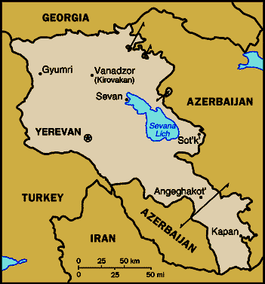

Slide 5
Questionnaire content
Respondents’ demographic characteristics
System of values of Armenians
Gender attitudes:
Perception of women’s and men’s qualities
Attitudes toward women’s and men’s roles in society
Women and men in decision-making
Political participation
Economic activities
Labor migration

Slide 6
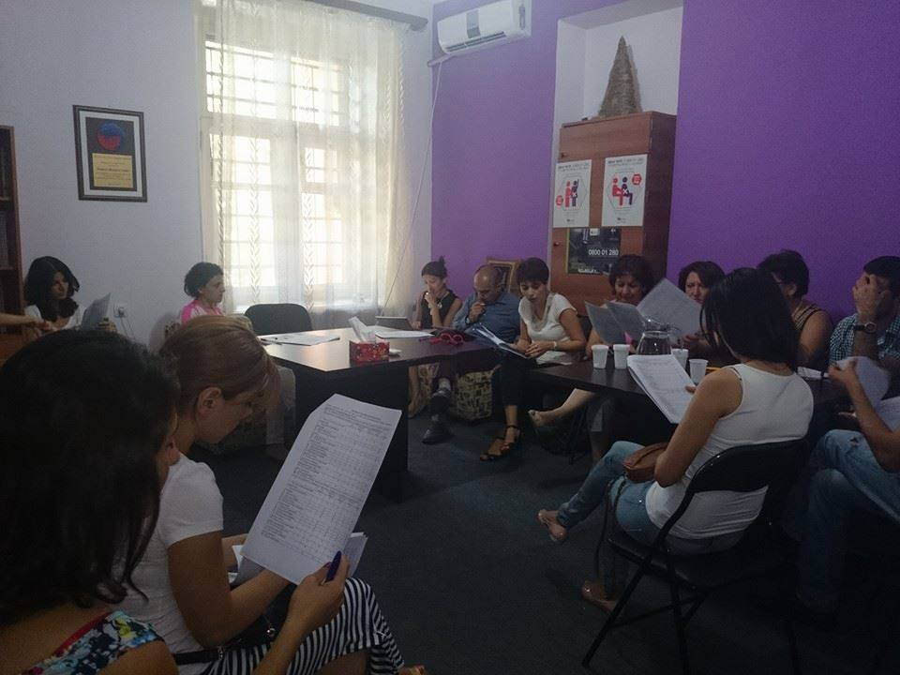
Survey preparation

Slide 7
Organization and Implementation of Data Collection
Data collection: October – November 2014
In each selected community—random selection of the first residence/respondent
Thereafter, selection of households using a random walk algorithm
In each household, an adult (18 years old +) was selected based on the proximity of birthday
Unavailable individuals were substituted by others with similar characteristics
Face-to-face interviews using paper questionnaires

Slide 8
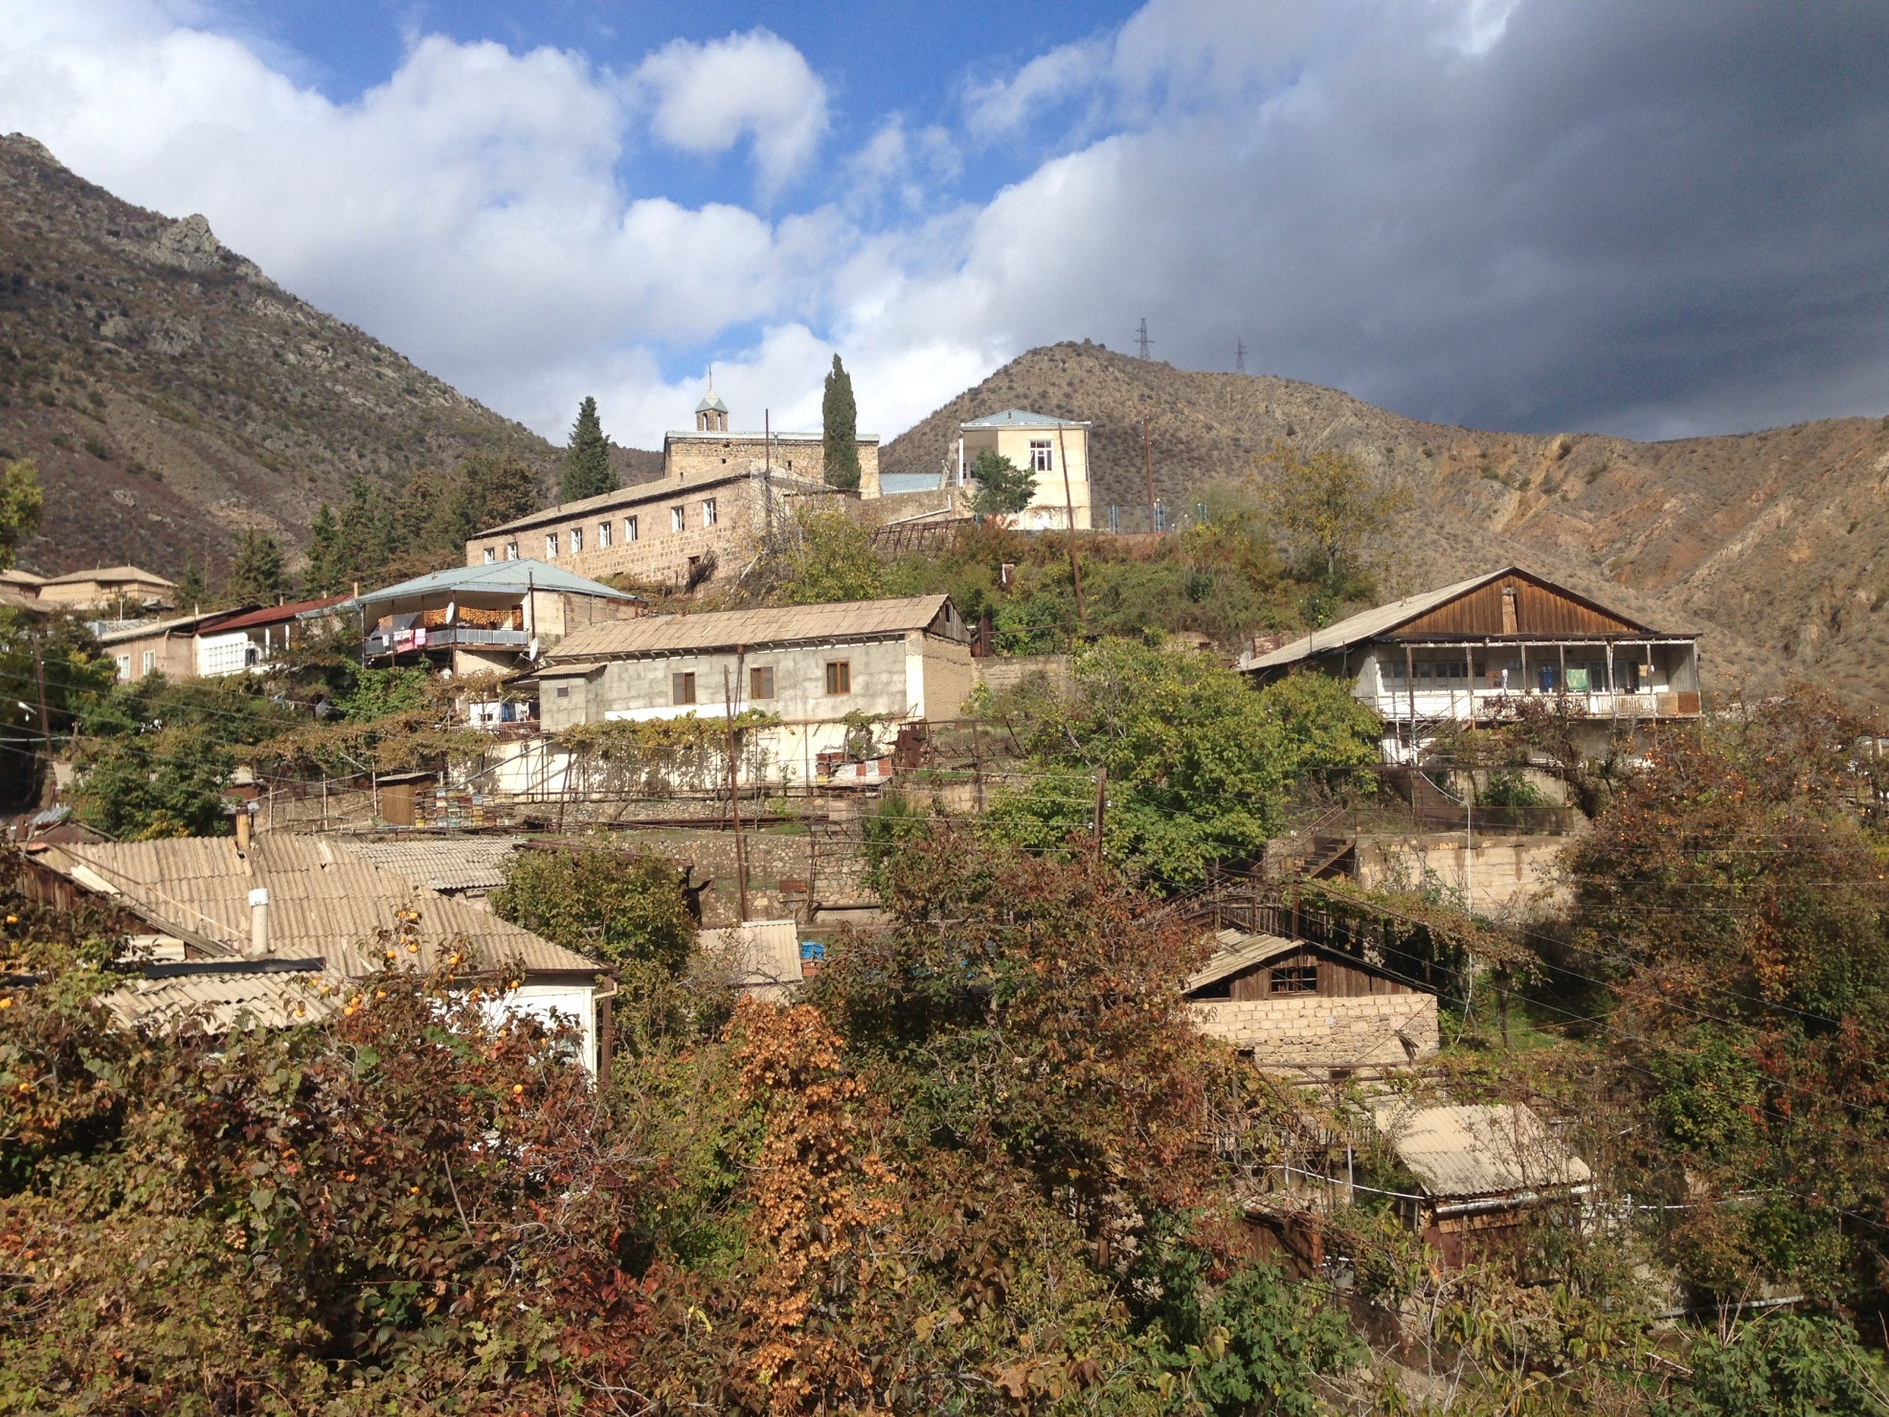

Slide 9
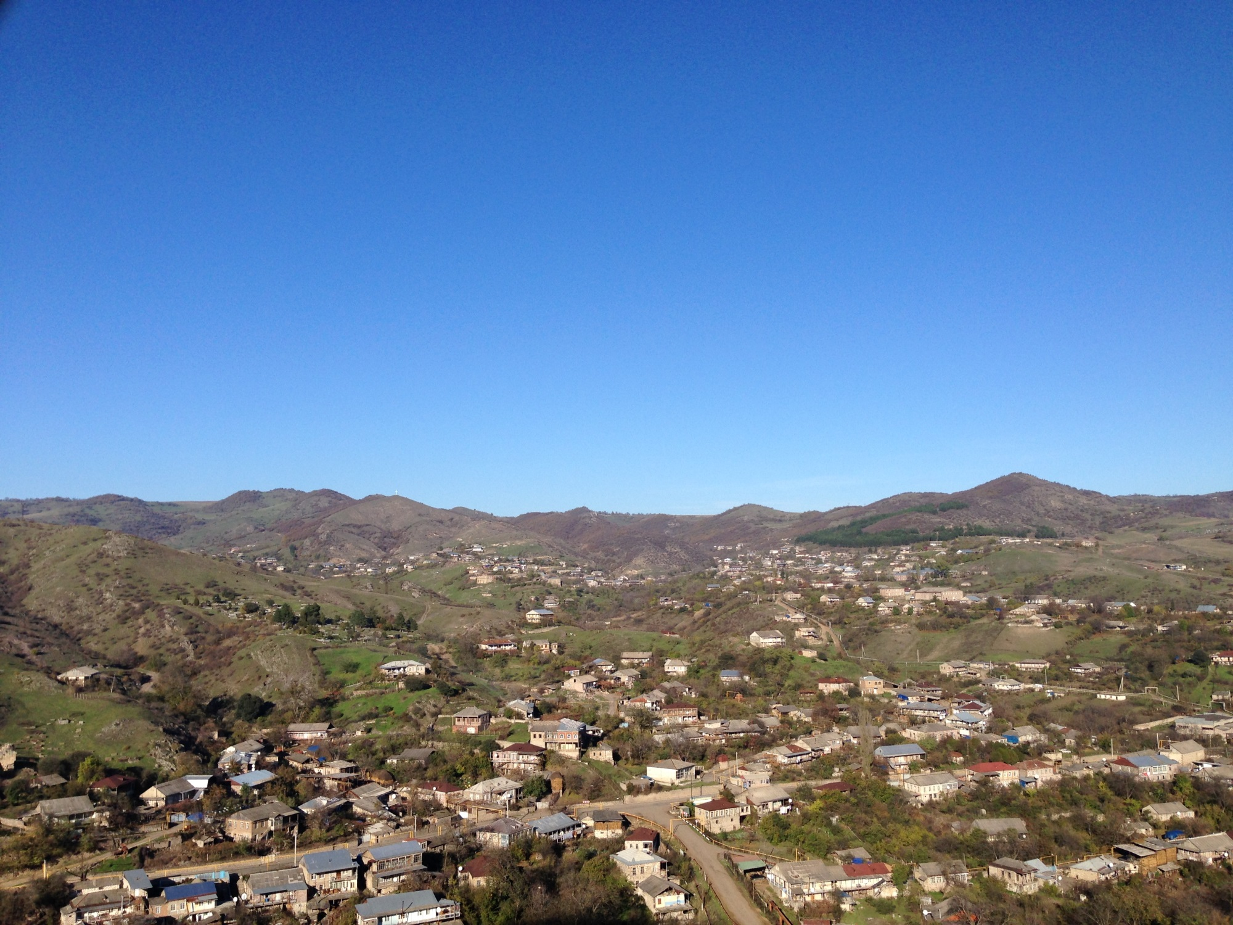

Slide 10
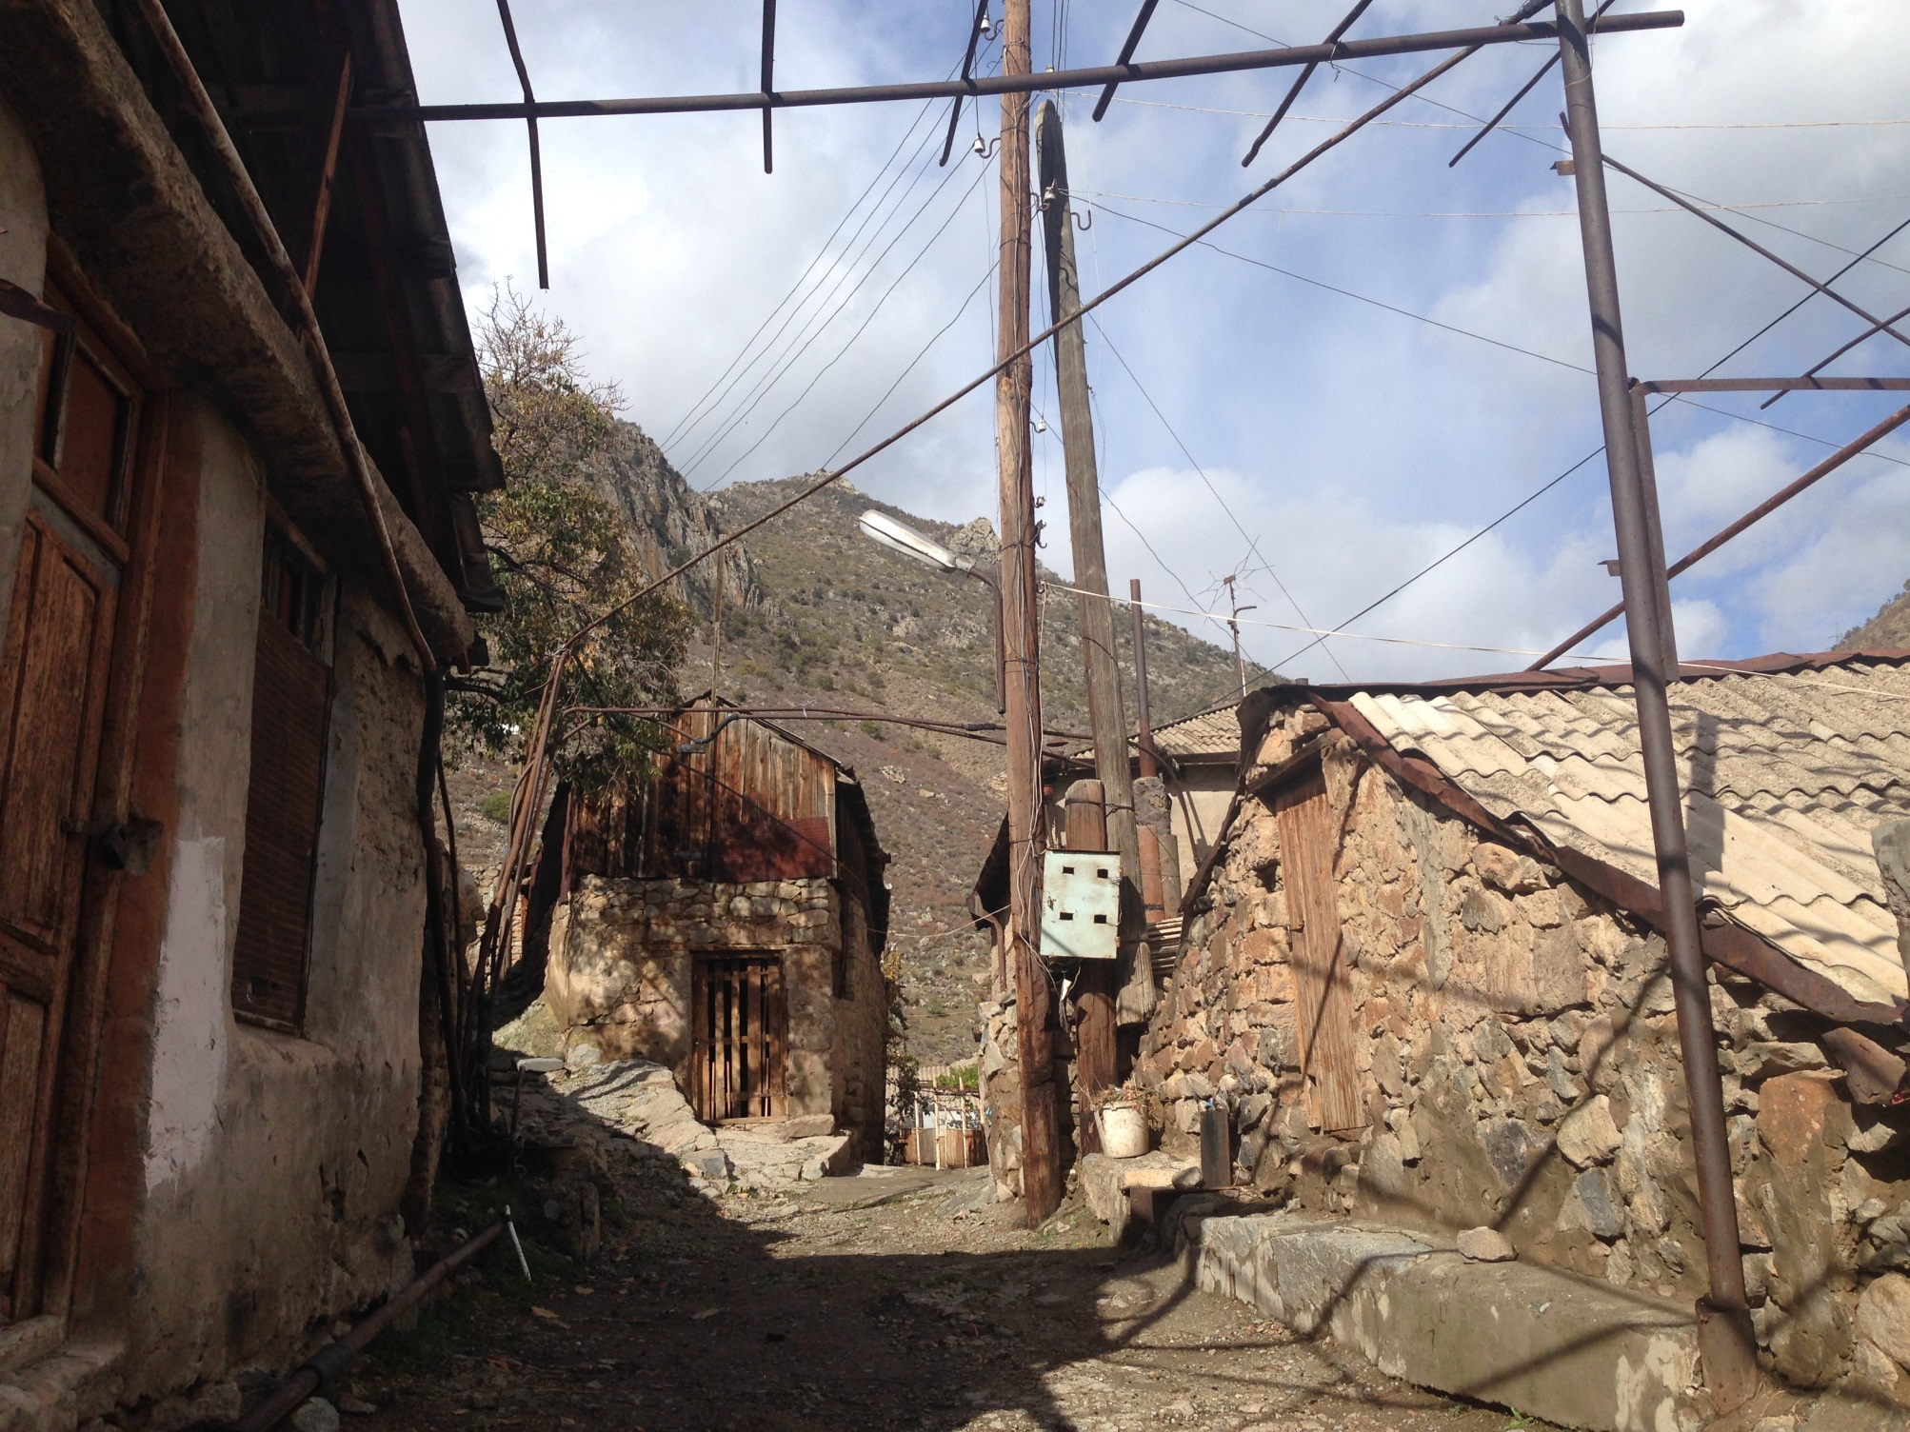

Slide 11
Quality control
Review of filled-out questionnaires by supervisors in the field
Confirmation of the interviews’ quality and coverage over the phone with selected respondents
Double data entry and subsequent reconciliation of the two databases
Additional data cleaning for the analysis

Slide 12
Selected Preliminary Results

Slide 13
“In your opinion, is there inequality between women and men in our society?”

Slide 14
“Women and men should have equal rights and should be given equal treatment.”

Slide 15
“Education is more important for a boy than for a girl”

Slide 16
“A man should always earn more than a woman”

Slide 17
“When jobs are scarce, men should have a priority right in getting a job, compared to women.”

Slide 18
Overall, men are better at business than are women

Slide 19
“Overall, men are better political leaders than women, and men should be elected”

Slide 20
Next Steps
More comprehensive and sophisticated analyses are currently underway
Preparation and wide dissemination of a detailed report on GBS findings (the Armenian version will be available by the very end of April 2015 and presented at the CGLS-YSU conference in May 2015)
Recommendations for policy-makers
Recommendations for non-governmental organizations
Galvanizing and redirecting the debate on gender issues in the media
Integration of GBS results into the curriculum of the new MA program on “Women, Leadership, and Development” at Yerevan State University (created under WLP)
Publications in Armenian and international policy research outlets
Fundraising for future waves of the survey

Slide 21
The Future: Why is the GBS enterprise worth investing in?
Sustainability of the current USAID investment through the Women’s Leadership Program – Armenia
Unique advantage of university-based policy research: university faculty and graduate students have scientific expertise unmatched in the NGO sector.
Yerevan State University, Armenia’s flagship institution of higher learning, is well respected in the country.
Up-to-date reliable and detailed data on the dynamics of gender relations and (in)equality in the country.
Huge potential for societal transformation: legislation, advocacy, outreach.
Replicability in other countries of the region and beyond
Direct and indirect benefits for the USAID image and impact in Armenia and the region
Relatively minor financial costs

Slide 22
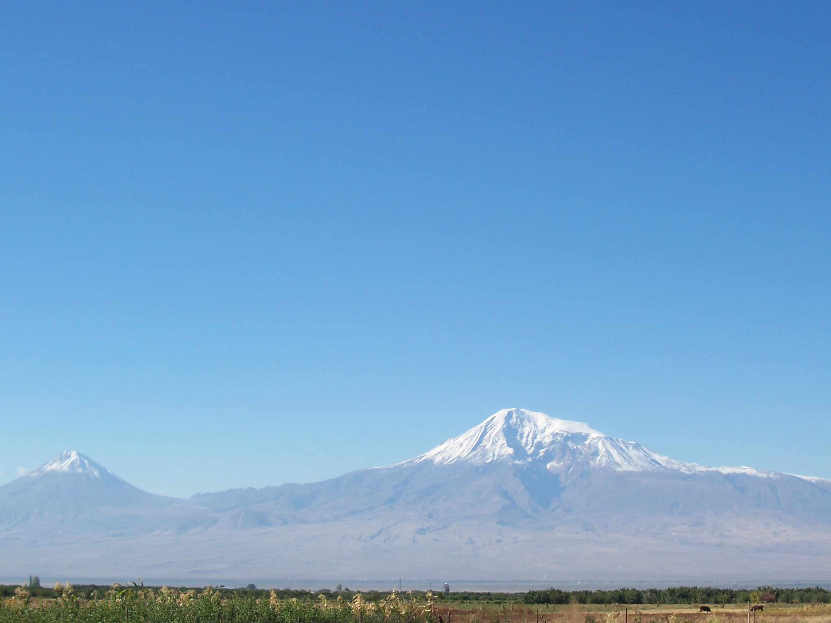

THANK YOU!

